Slide 1

Product Observations
Inshorts
By: Mayank Kumar

Slide 2
How do I often use the product:
I use inshorts almost everyday because of various below reasons:
Quick Updates
Time-Efficient
Wide Coverage
Customizable Interests
Mobile Accessibility
Professional Conversations
Visual Insights
: Provides concise news summaries to stay informed without consuming much time
: Helps manage time effectively by delivering key information in 60 words.
: Covers diverse topics like business, technology, and current affairs in one app.
: Enables tailored news based on preferences, ensuring relevance.
: Easy to access on-the-go for real-time updates.
: Keeps you informed, enhancing participation in discussions and decision-making.
: Infographics and headlines offer a quick understanding of complex topics.

Slide 3
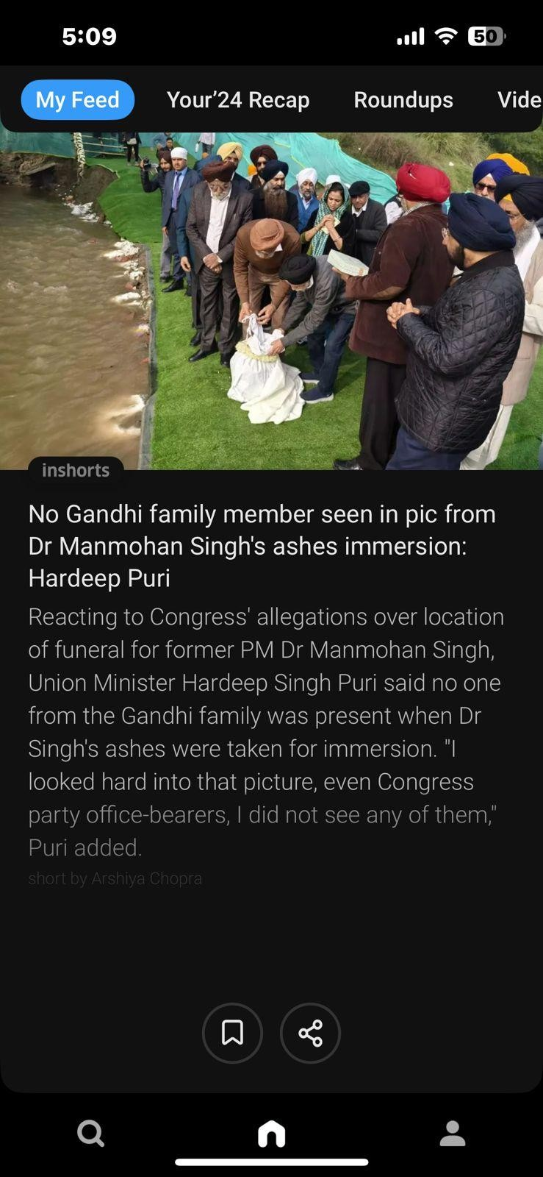
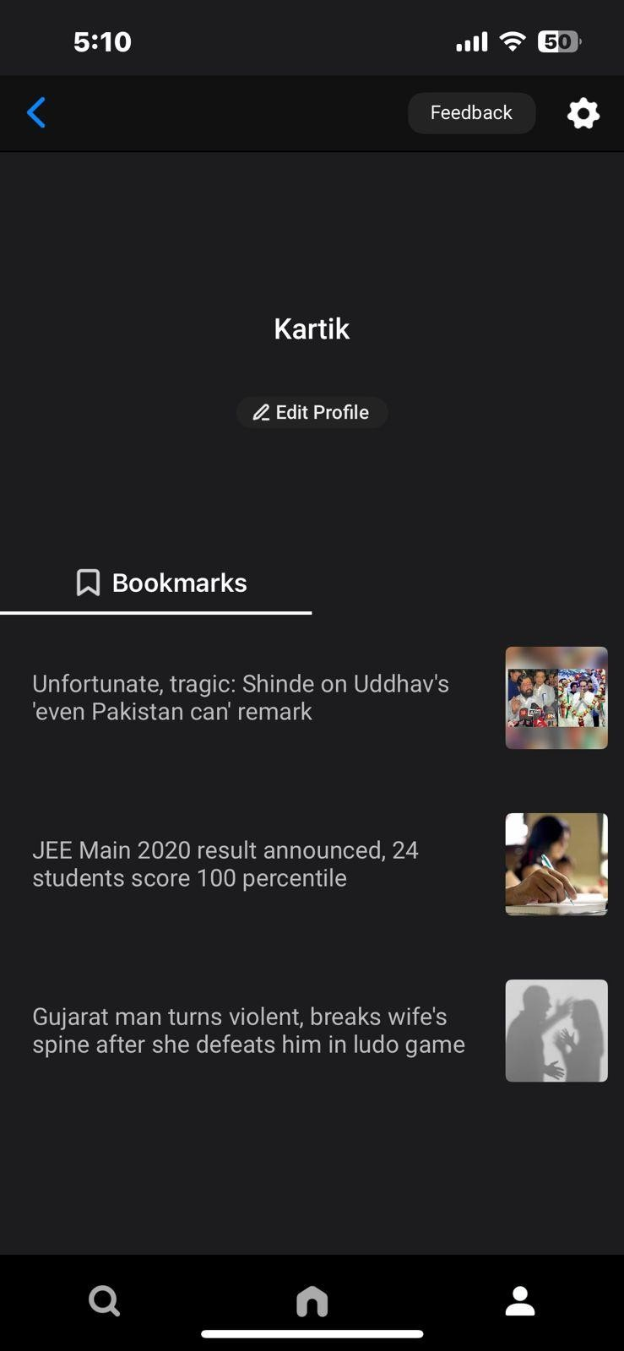
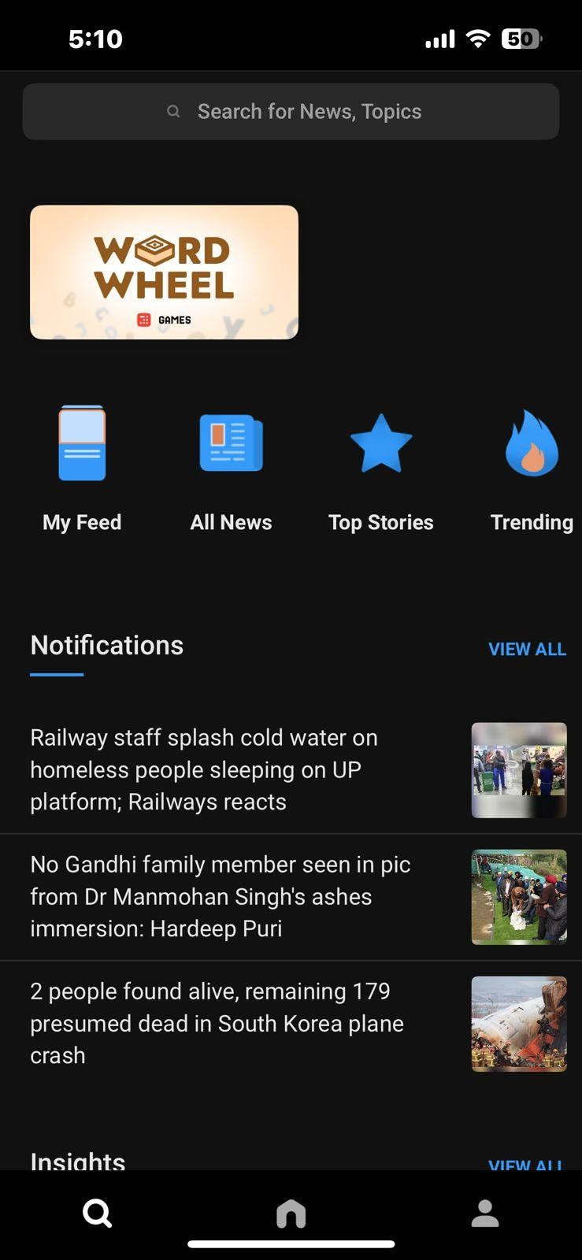
Different set of screens to perform the desired action:
Screen-1 Home screen Screen-2 Profile Screen Screen -3 Search Screen
Mayank

Slide 4
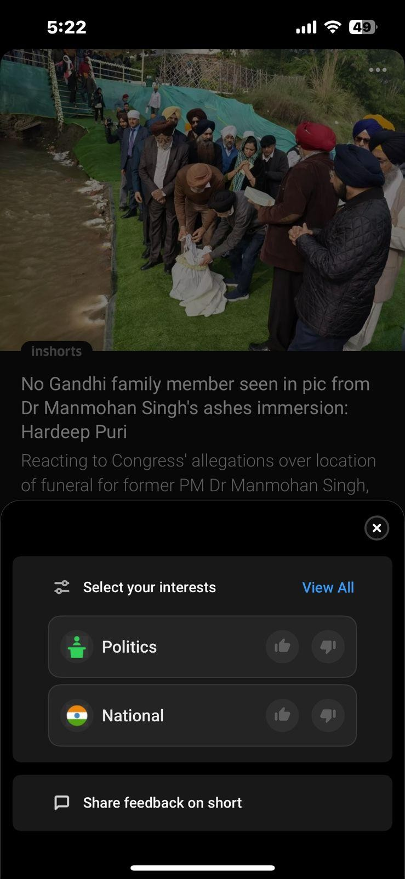
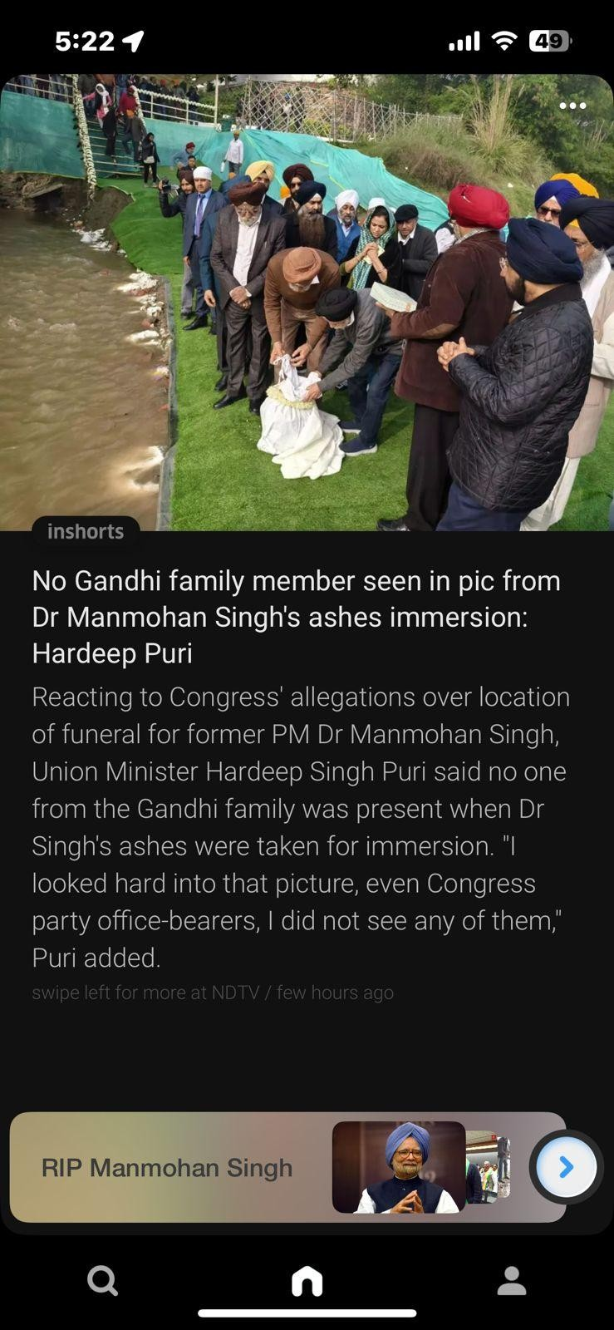
Offers users the option to view a news image along with a concise description for quick insights.
Provides users with an ellipsis menu option, enabling them to bookmark specific news articles for easy access later.
Allows users to select interests, personalizing article recommendations on their home screen.
Allows users to access detailed information on related recent news through the bottom tab, ensuring seamless navigation.
Provides users with the option to share feedback about the platform.

Slide 5
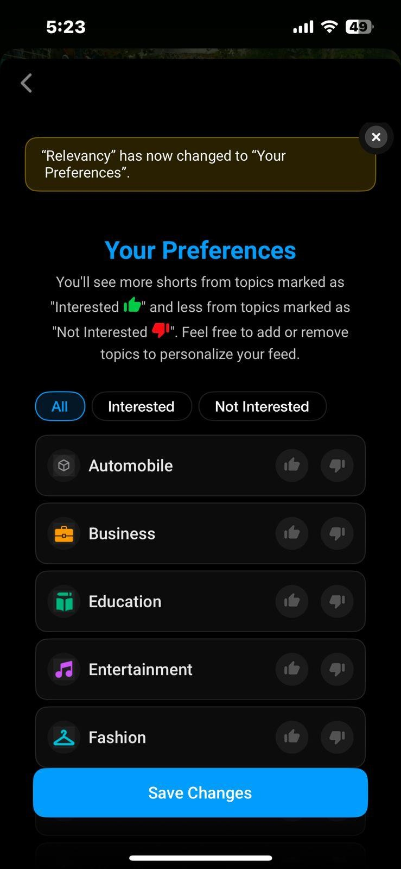
Users will also be able to view a disclaimer regarding their preferences, displayed by the app upon accessing this screen, enhancing the overall user experience.
Provides users with the option to customize their industry preferences, ensuring the home section displays news tailored to their interests.
Allows users to select preferred and non-preferred industries on the same screen, adjust preferences, and save changes automatically for personalized news in their respective sections.
Users are provided with an option to save the changes made on this screen

Slide 6
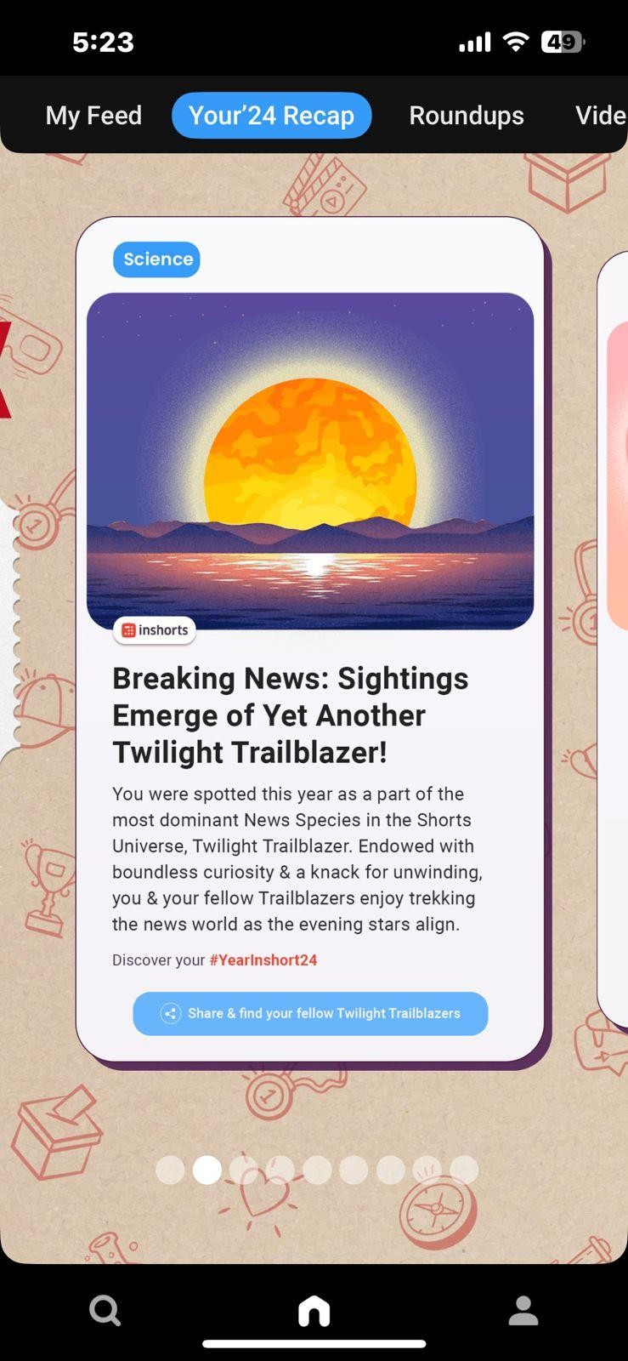
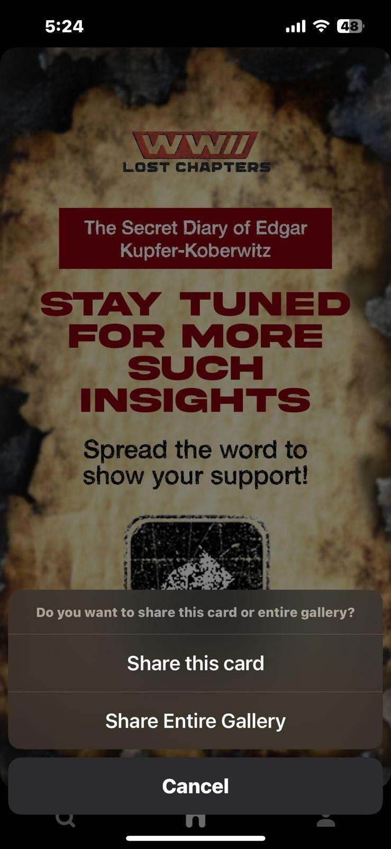
Provides users with the option to view a recap of the most notable news from the current year under the Your24 Recap section n the home screen
Enables users to access a Most Notable articles under “Insights" section on the home screen
Users can click on any relevant article to view its details, allowing them to catch up on missed articles from the current year.
Users will also have the option to share these insights in either card format or as part of the entire library.

Slide 7
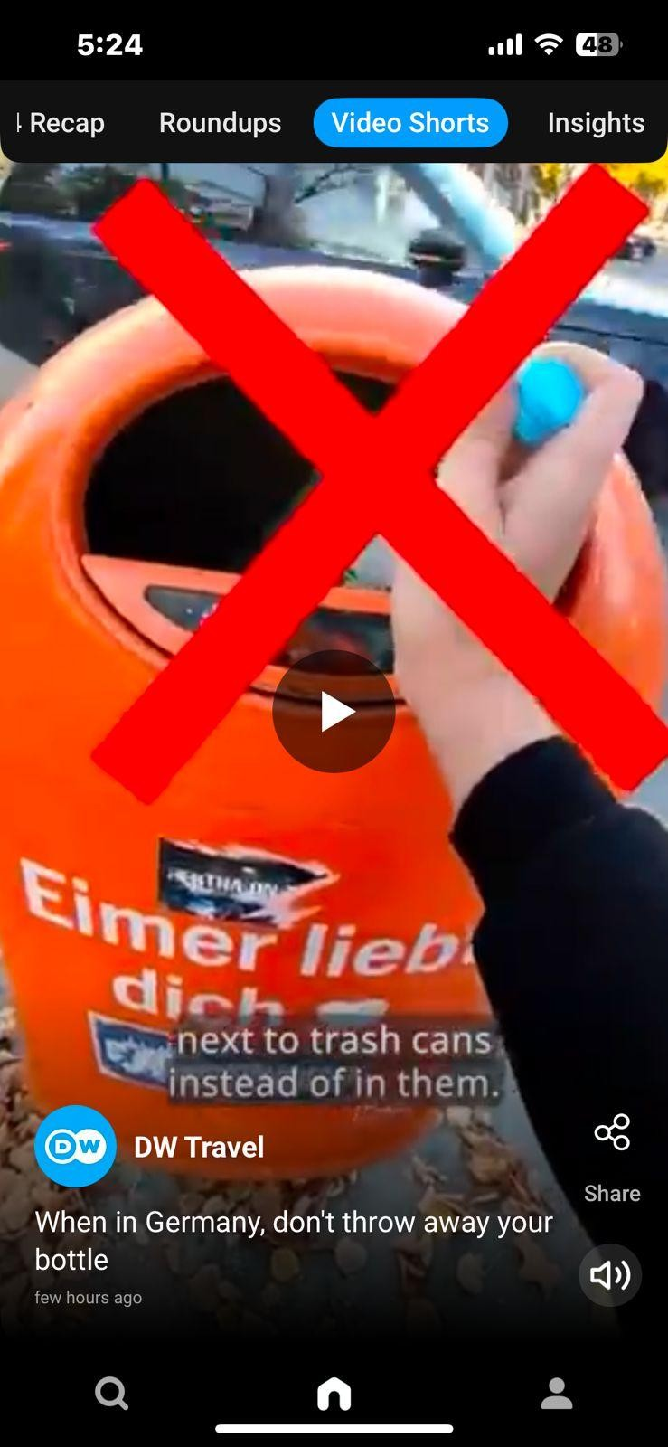
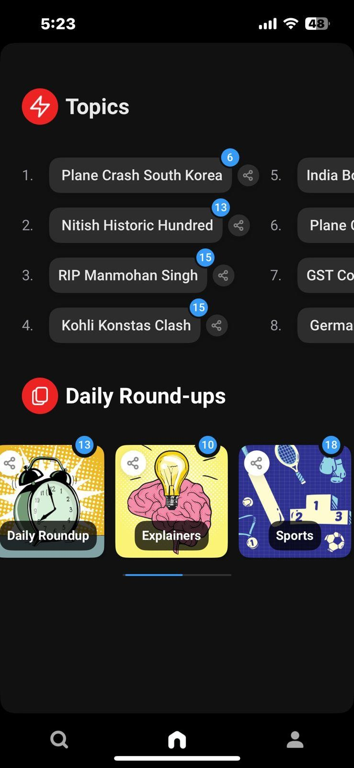
Allows users to access "Most Notable Videos" in a short format with captions, available under the "Video Shorts" section on the home screen.
Users have the option to view the most recent 8 topics, which they can click to explore, under the "Roundups" section with the count of articles shown for each topics
Users have the option to view daily roundups organized by category, with the article count displayed for each category, allowing them to explore articles within each section.
Users also have the option to share the video with others across various social media platforms.
Users also have the option to completely mute the audio of the video

Slide 8
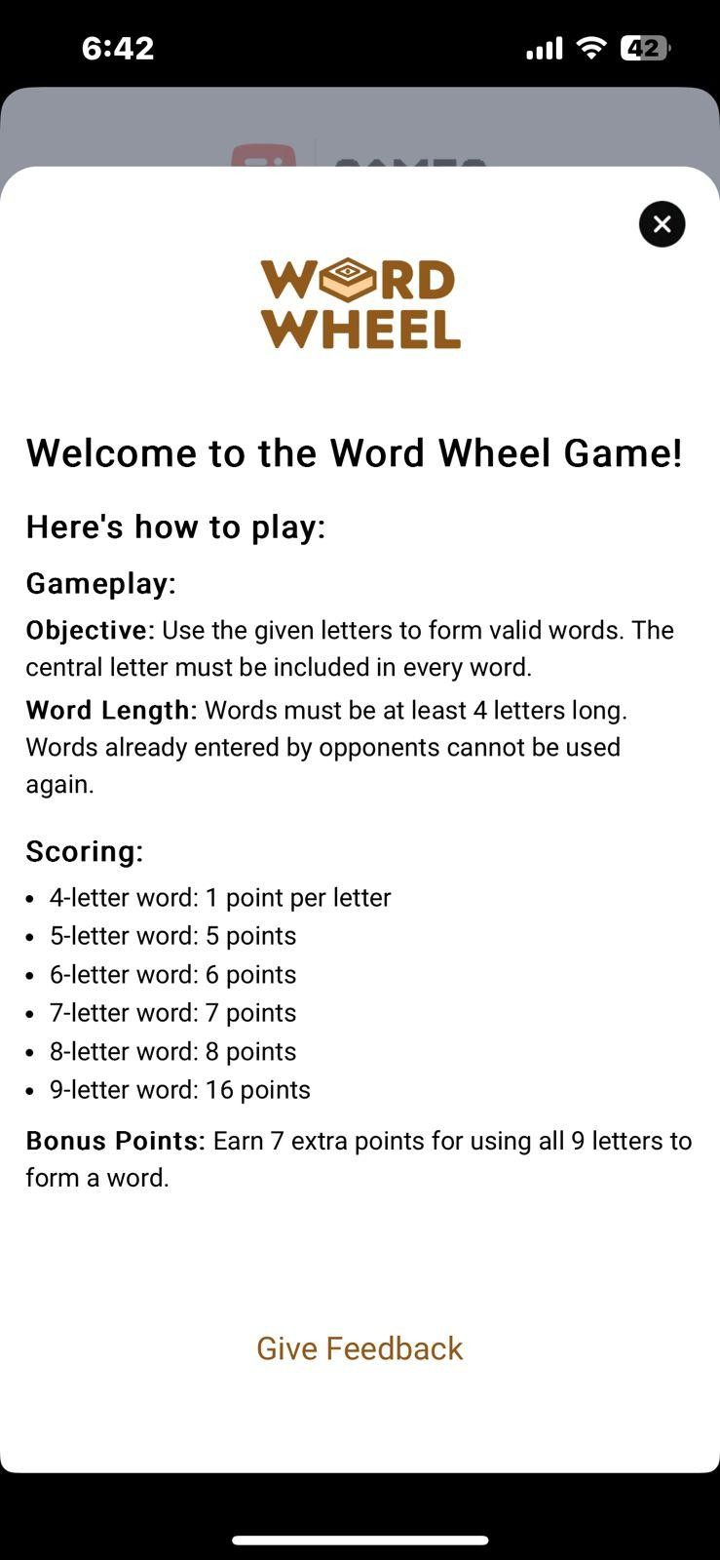
Users have the option to search for any news, topics, or articles to view detailed information.
Users have the option to click on the "Games" section and play the game titled "Word Wheel."
Users have the option to explore various sections, including
My Feed - which displays personalized content
All News - offering a comprehensive list of news articles
Top Stories - featuring the most popular & significant news items
Trending - highlighting the latest and most discussed topics.
Users also have the option to view notifications, as well as access the "Trending" and "Insights" sections, directly from the search tab for quick and easy navigation.
The rules for playing the game will also be clearly displayed to users, providing them with detailed instructions to ensure a smooth and enjoyable experience.

Slide 9
Users are offered the opportunity to share their feedback about the platform, enabling them to voice their opinions, suggest improvements, and contribute to enhancing the overall user experience.
Mayank
Users are given the ability to engage with their profiles on the platform by accessing and editing their personal information, allowing them to update and customize their details as needed for a more tailored experience.
Users are provided with the option to bookmark news articles or information of interest, enabling them to conveniently revisit and explore the content in greater detail at a later time

Slide 10
Thank you!

